Slide 1



THE PATH TO ORAL HEALTH
The Clients: Dr. Eilerman & Dr. Davila from SIU School of Oral Medicine
The Team: Alex Wernex, Jarod Spencer, Nicole Morgan, Sophia Miller

Slide 2




01
TIRED of hours upon hours of BORING lectures
A 2023 study found that through challenge-based video games student performance increased 89.45% compared to traditional lecture-based classes

Slide 3

01
02
THE PROBLEM…
Trouble making studying engaging
Difficulties in retaining information
Our design…
Interactive learning
Engaging content
Allows for retention of difficult terms
Used for Future Research Paper!

Slide 4
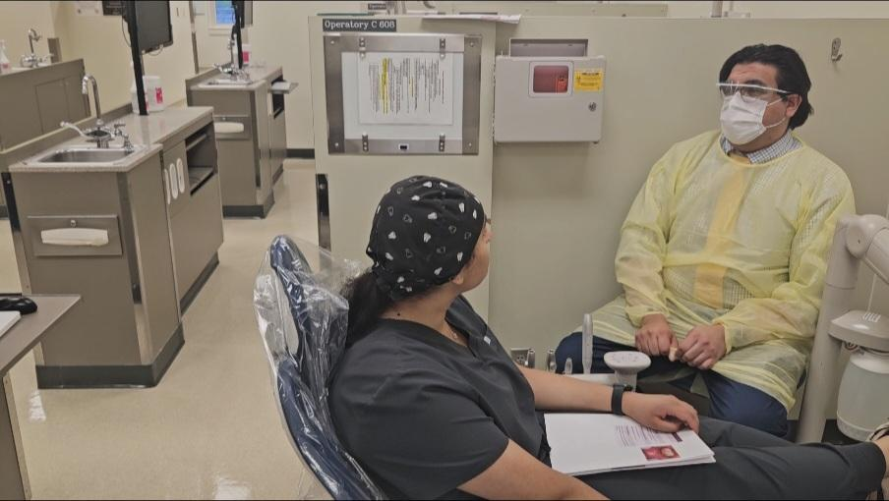

03
CLIENT CLINICAL MOCK MEETING

Slide 5
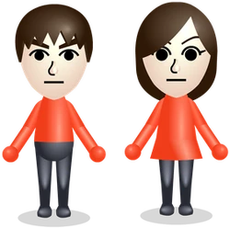
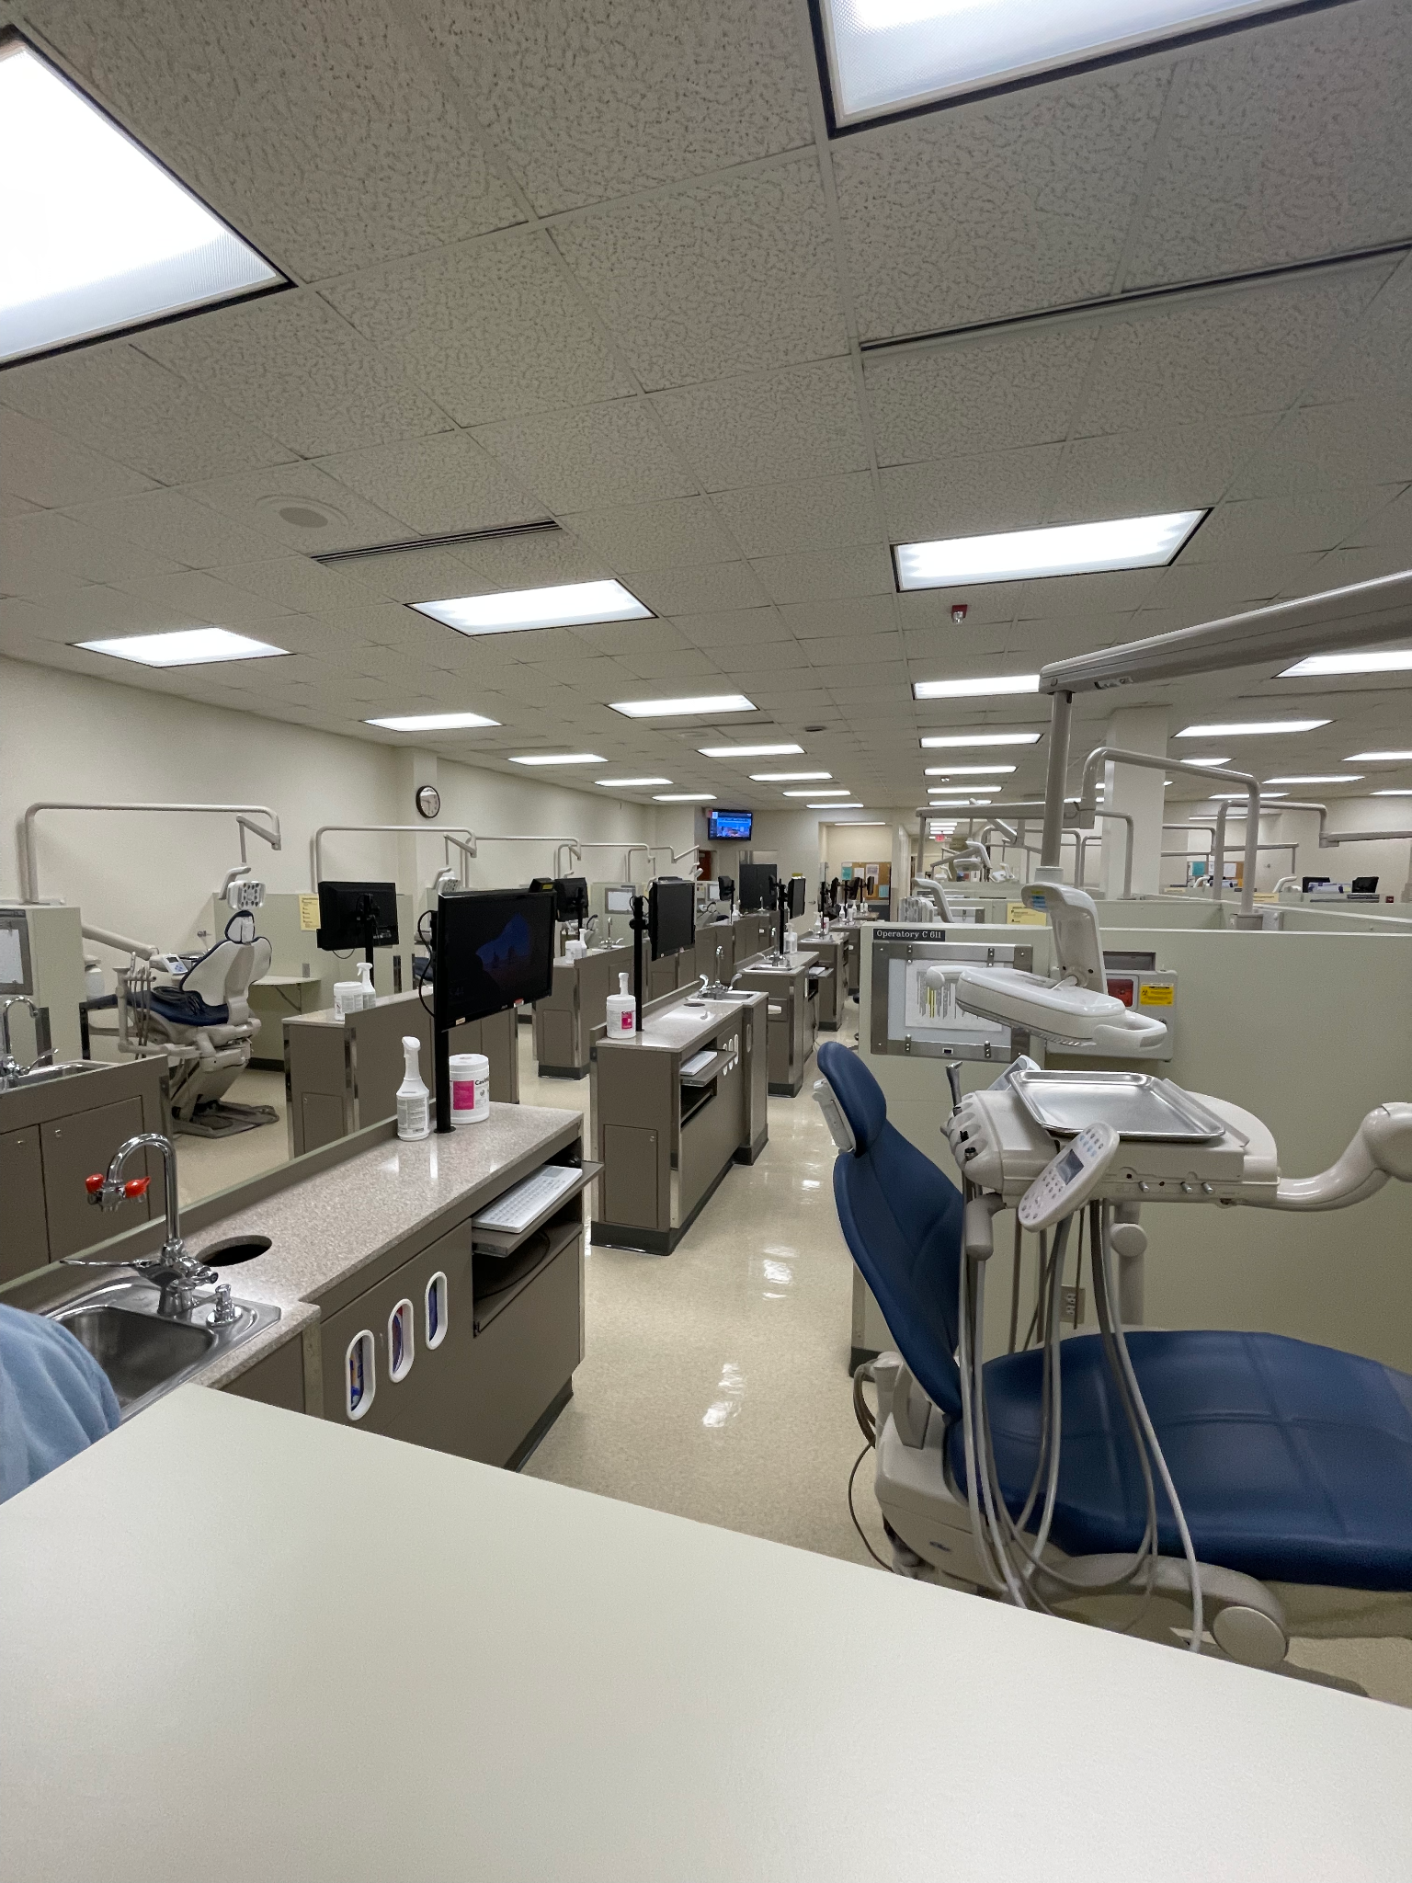
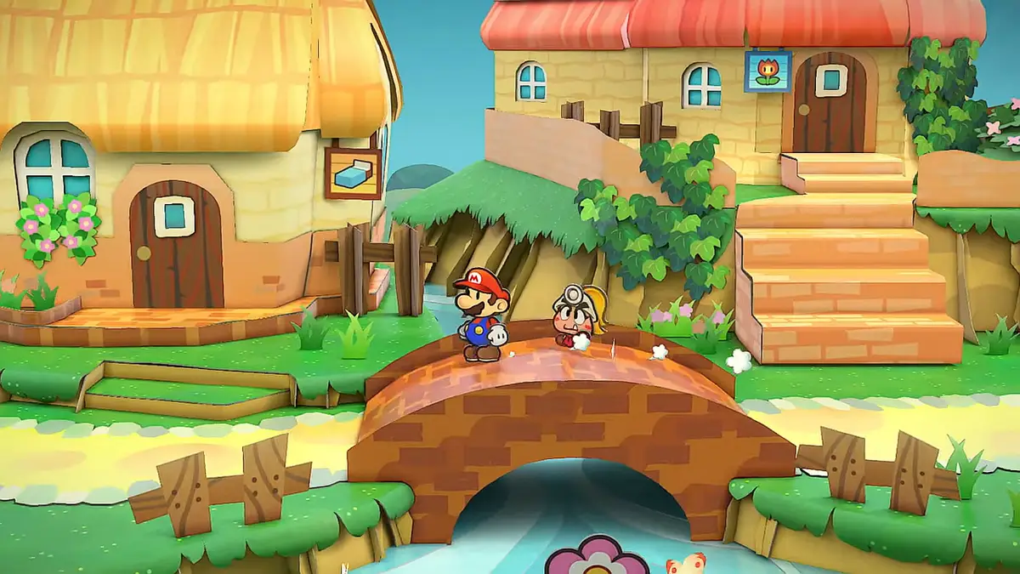
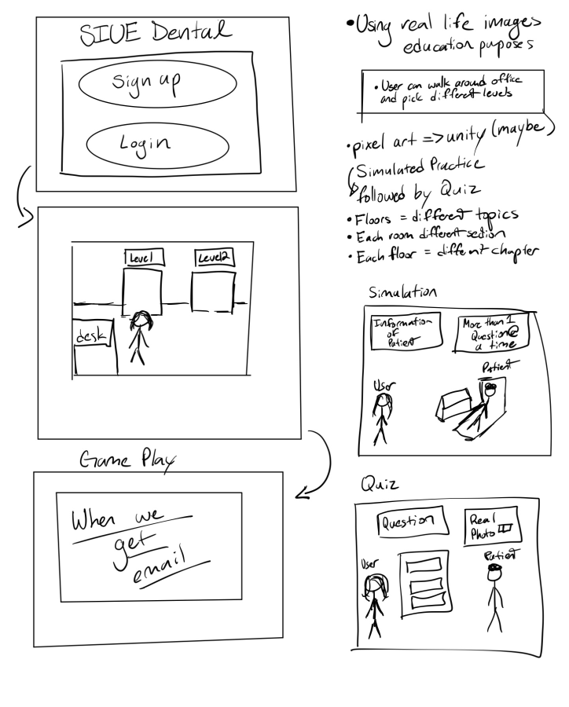
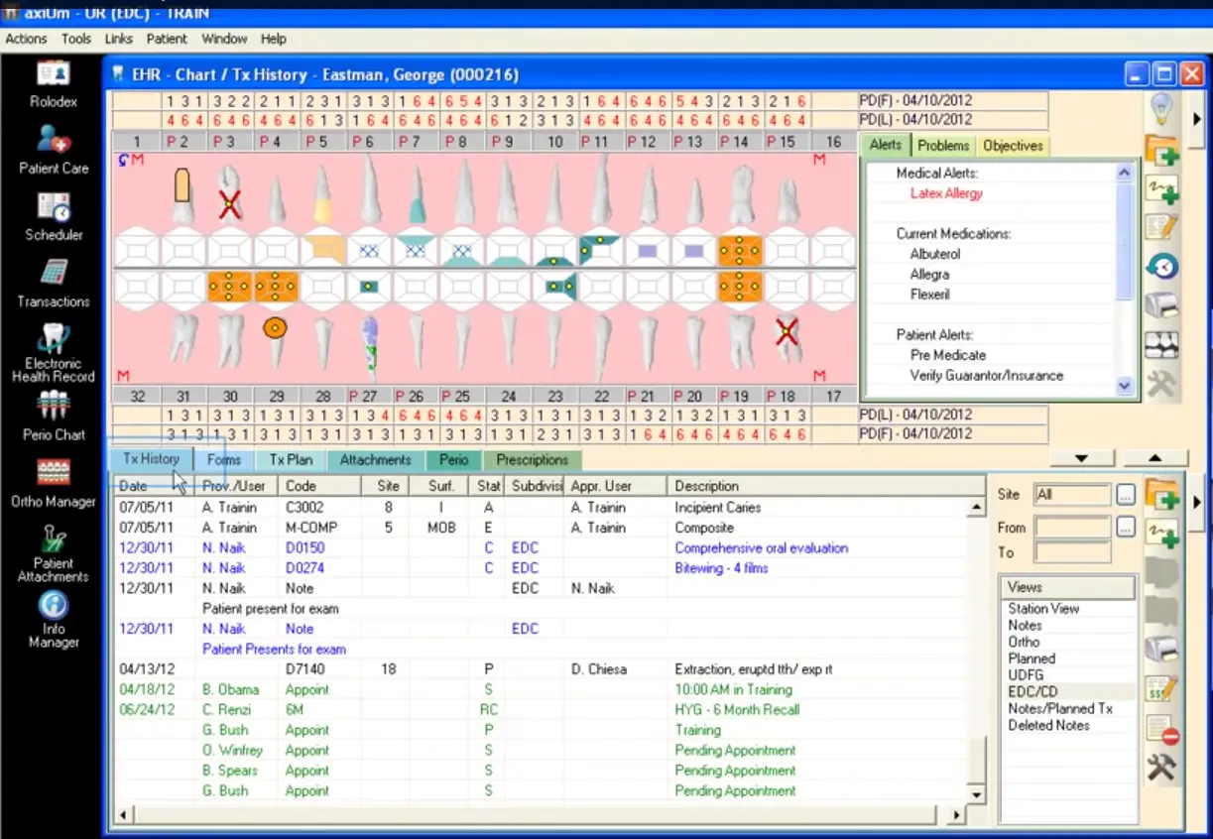
04
Game Inspiration

Slide 6
05
Live demo
The Path to Oral Health

Slide 7
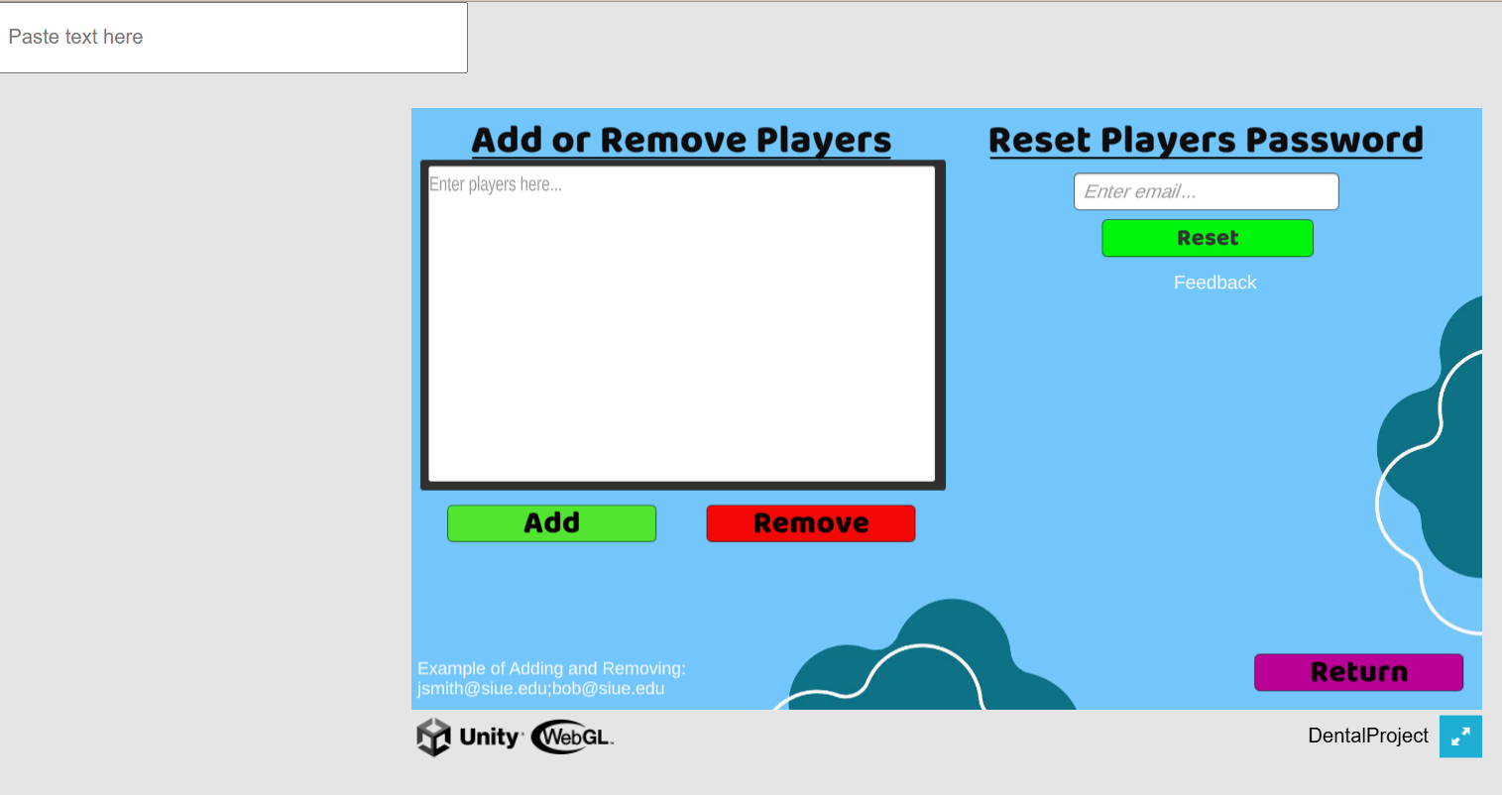

Admin Panel
06

Slide 8
04
BACKUP DEMO

Slide 9




07
SOFTWARE

Slide 10


08
SOFTWARE OVERVIEW
Key Functionalities and Features:
Authentication
Level Traversal
Firebase Storage of Progress
Uniqueness:
One of the only Educational Serious games being developed in the Oral Medicine Field to help students retain information easier.

Slide 11
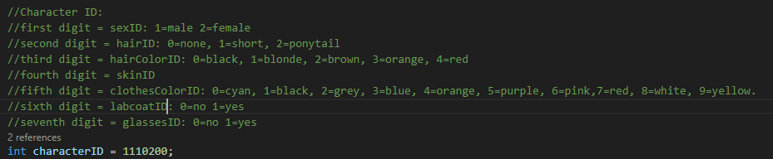
09
HOW CHARACTER CREATION IS SAVED

Slide 12
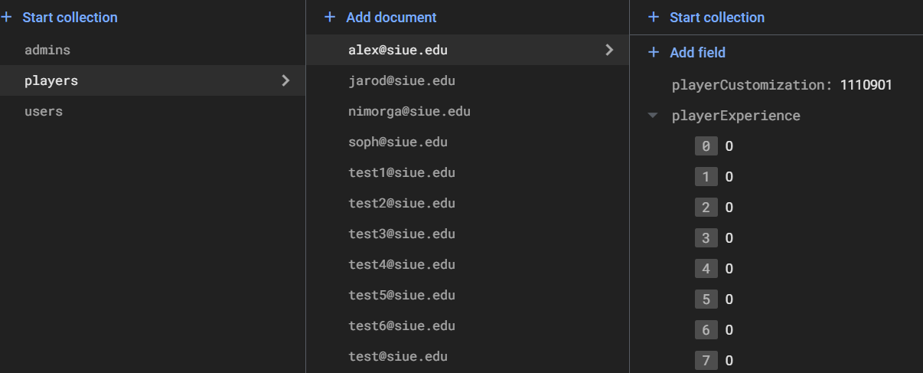

10
Where the Information Is stored

Slide 13
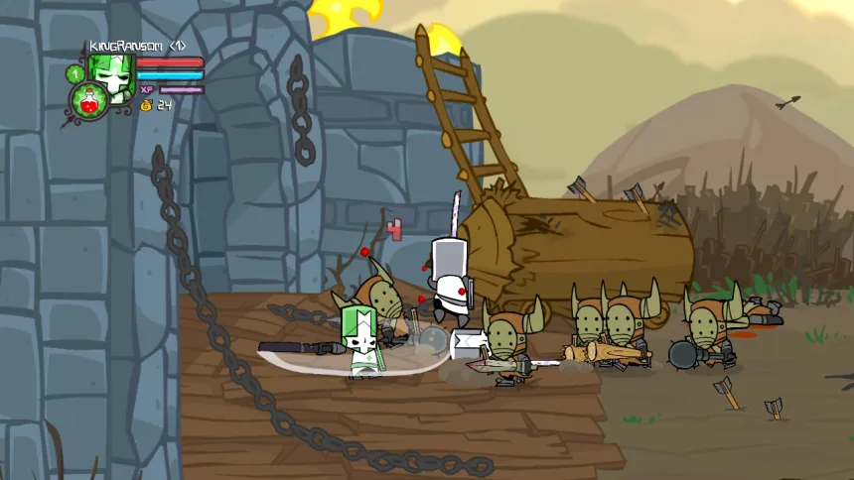
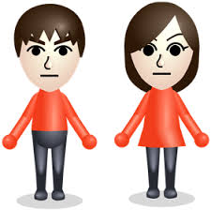
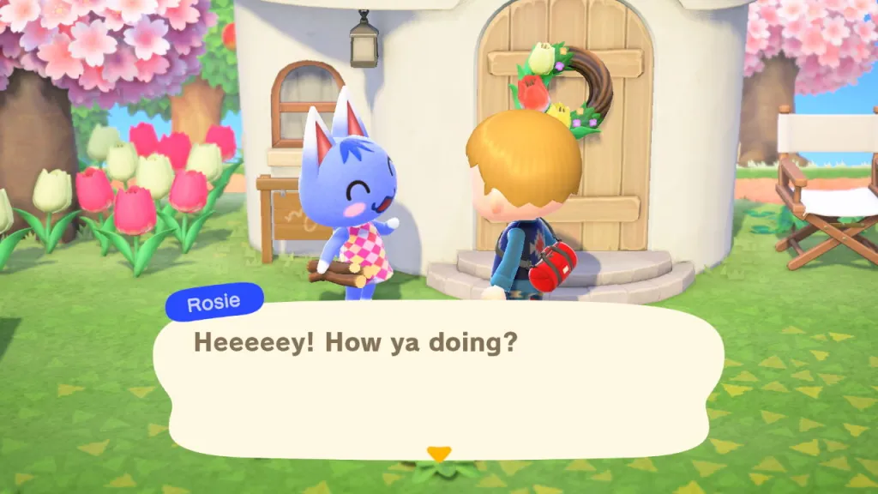
07
ART STYLE INSPIRATION
07
Art Style
2.5D Style
Character creation: Nintendo Wii like models
Character Sounds: Verbal sound like Charlie Brown or Animal Crossing

Slide 14

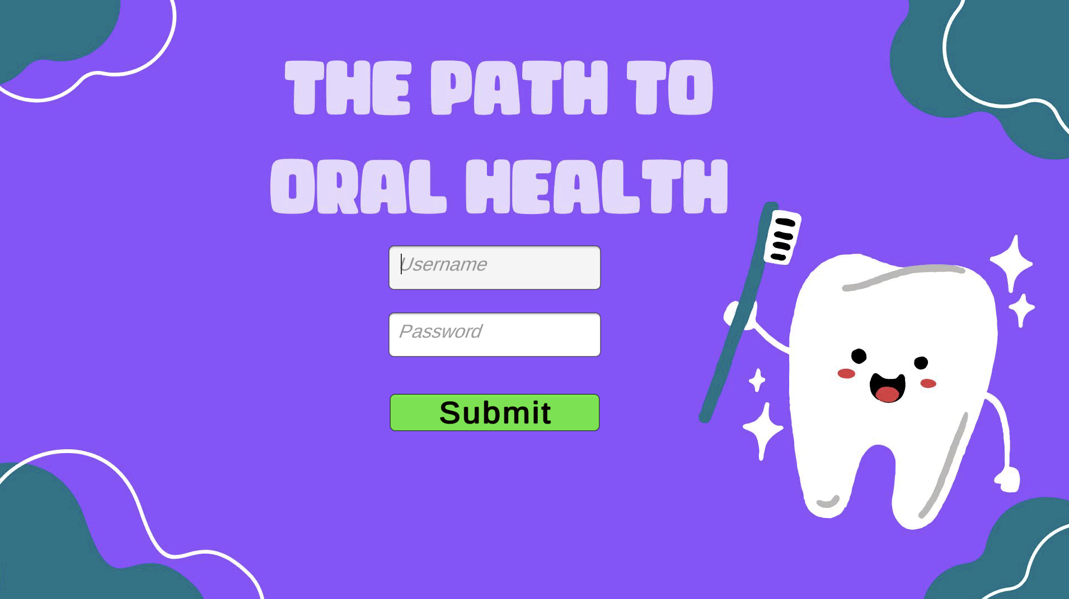

08
08
USER INTERFACE
Login Page
User Authentication
Admin Control
Character Creation

Slide 15
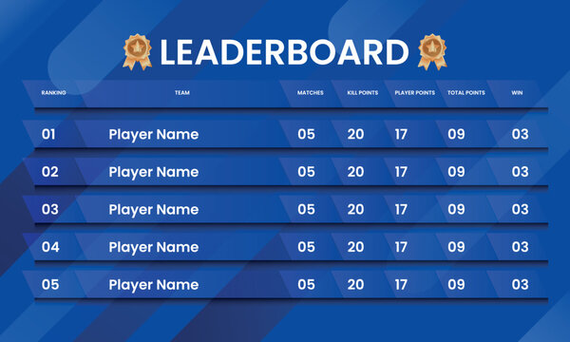
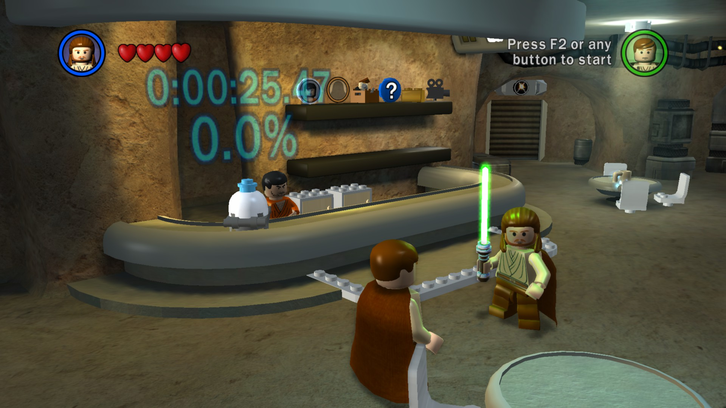
09
09
USER INTERFACE
Desk Hub
Login screen
Character Unlocks
Track Grades
Players, Administrators, Leaderboard

Slide 16

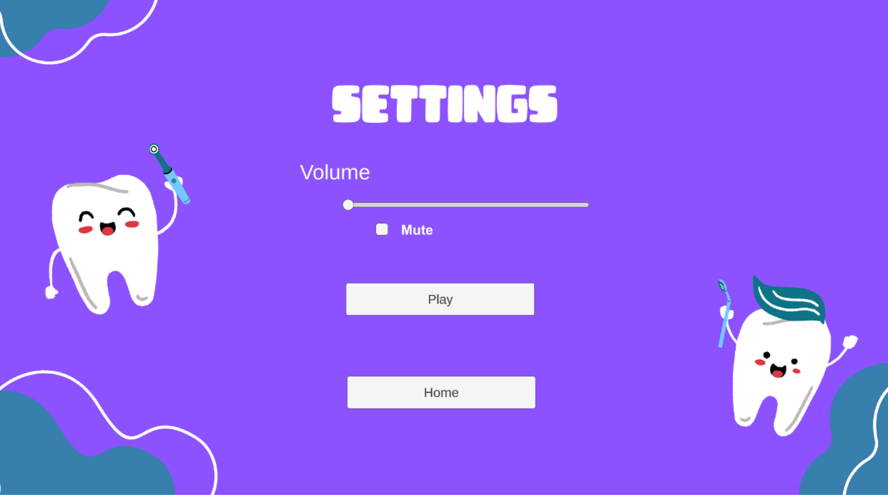


10
10
USER INTERFACE

Slide 17

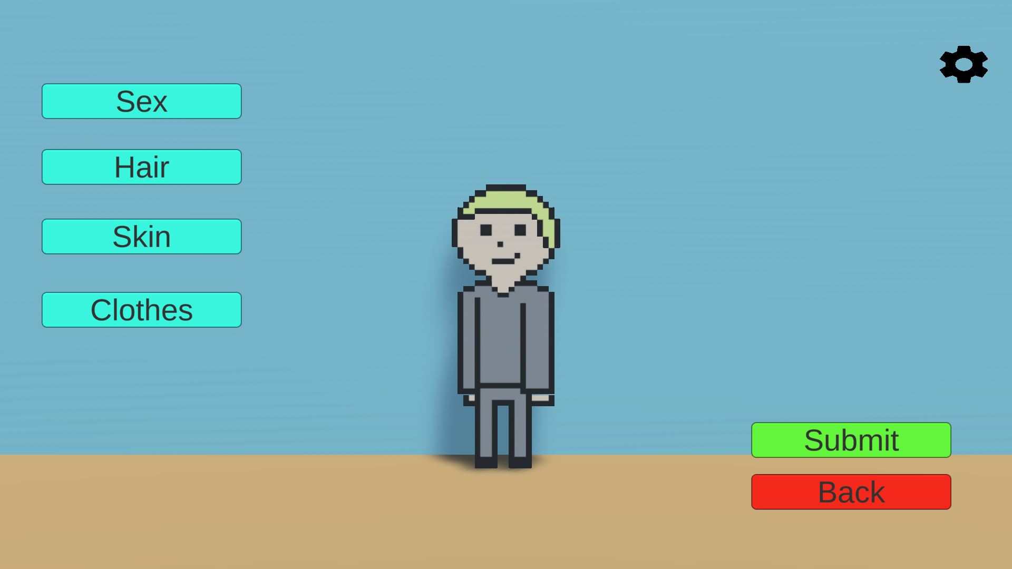

11
11
USER INTERFACE
Character Creation
Saved to Firebase
Music!

Slide 18

13
13
USER INTERFACE
Settings
Help Button for controls/tutorial
Volume Adjustment
Return to main menu
Grade/Progress
Save button for assurance

Slide 19
14
14
USER INTERFACE

Slide 20
15
15
LEVEL SELECTOR SCENE
Bays
Designed after SIU’s clinics
Desks
Blurb about patient

Slide 21
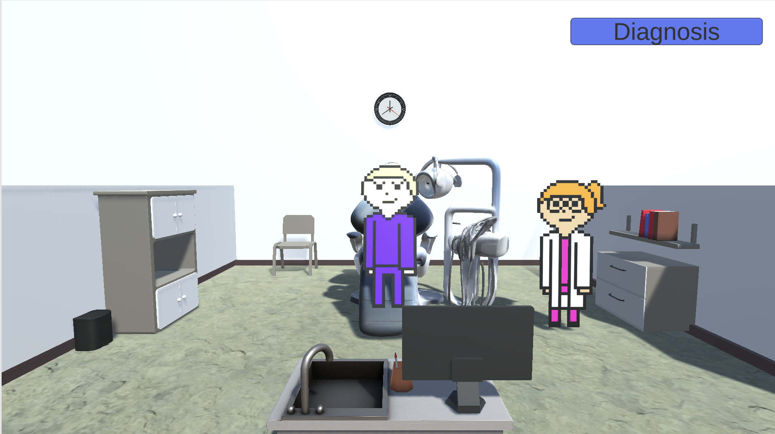

16
16
USER INTERFACE

Slide 22
17
17
AXIUM IMPLEMENTATION
Software dental students use in school
Organizes
Patient information
Student schedules

Slide 23
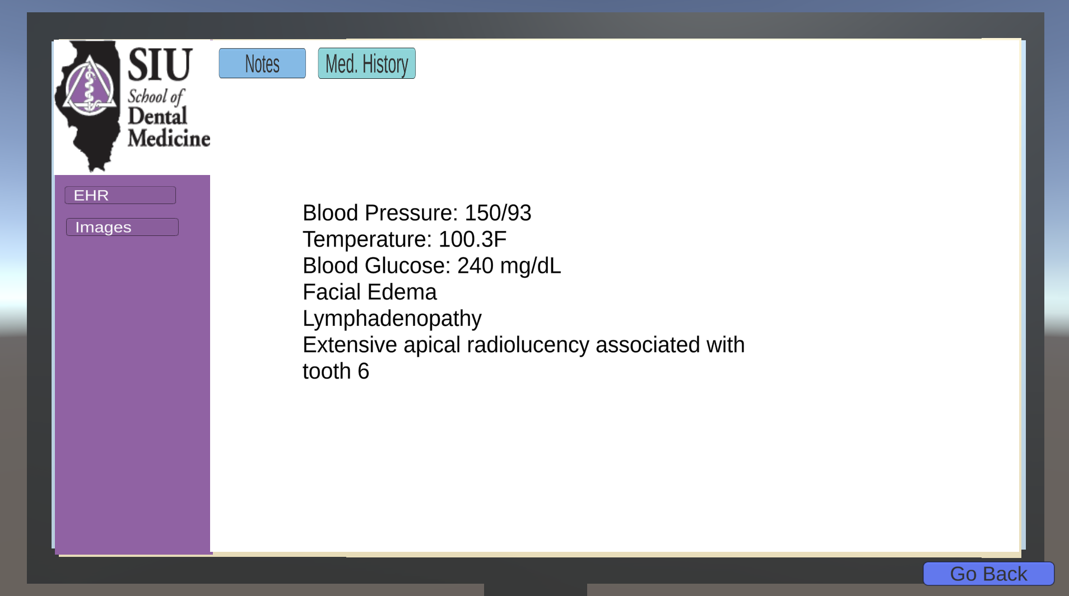
18
18
USER INTERFACE

Slide 24



11
BENEFITS
Improved Retention
Active Participation
Real-Time Feedback
Complex Case Exposure
Instructor Oversight
Used for Future Research Paper!

Slide 25
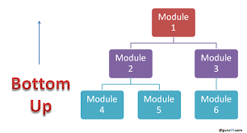

09
TESTING
Integration Testing: Bottom Up
One game object at a time
One level at a time
Playtesting
Group Alpha Testing
Closed Beta Testing
SIU Dental Student Testing

Slide 26
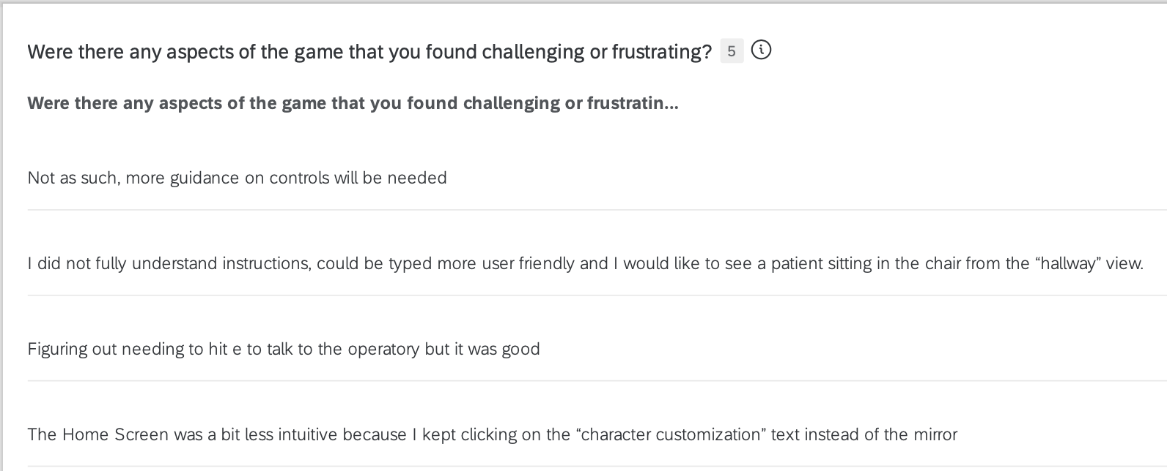
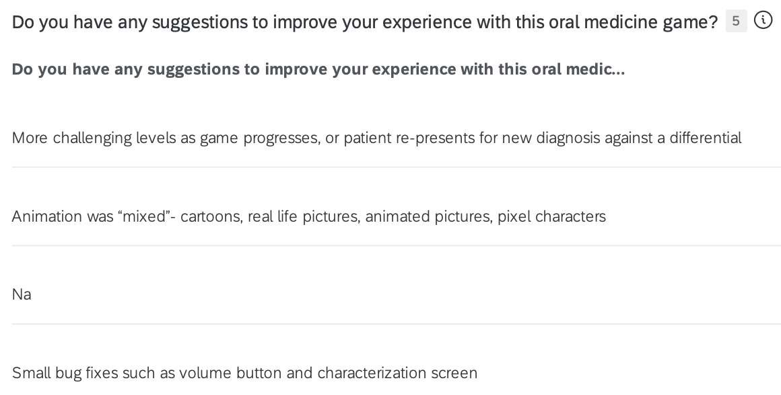
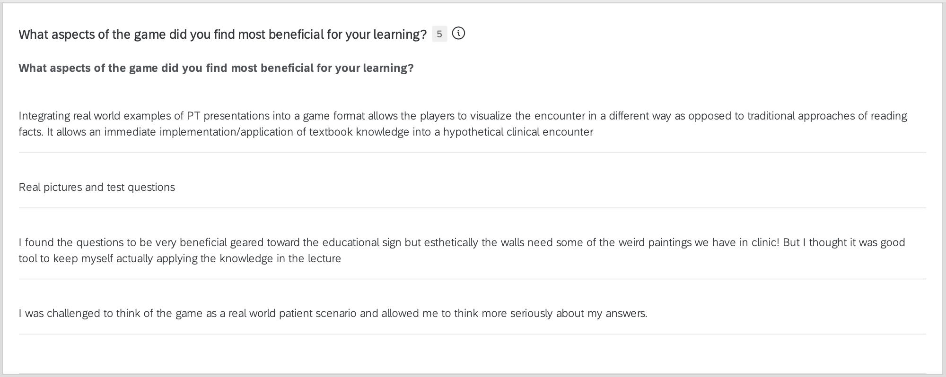
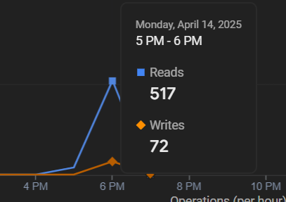
12
PLAY TESTING

Slide 27
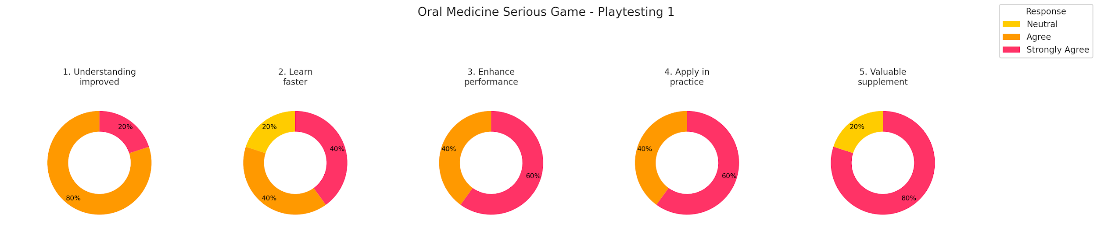
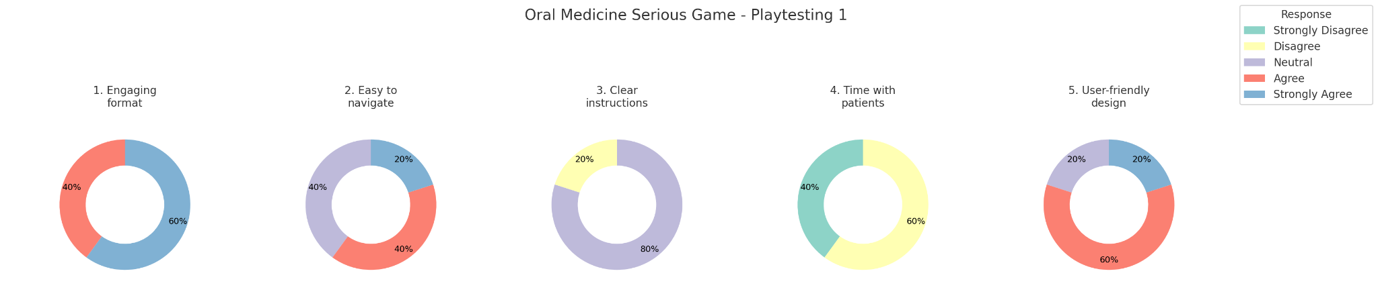
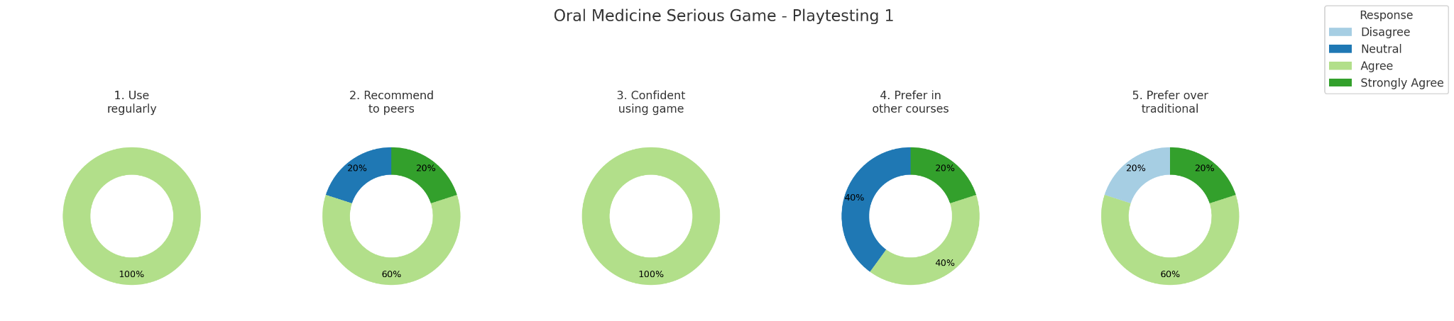
13
RESULTS FROM PLAYTESTING

Slide 28
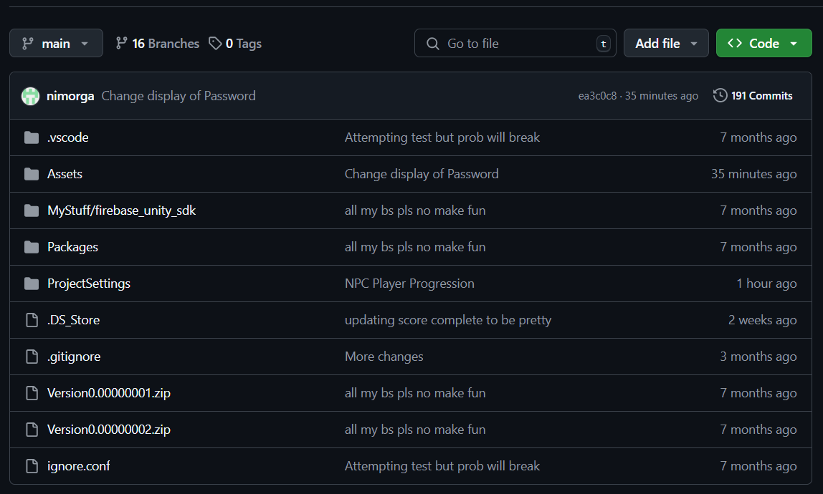
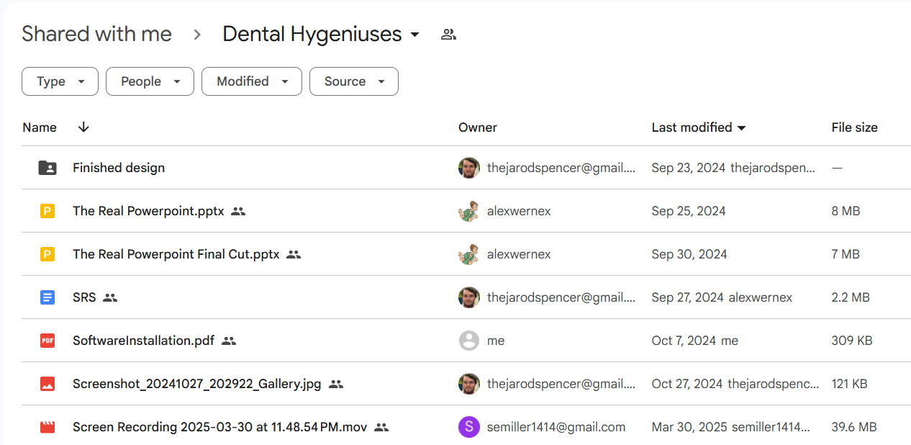
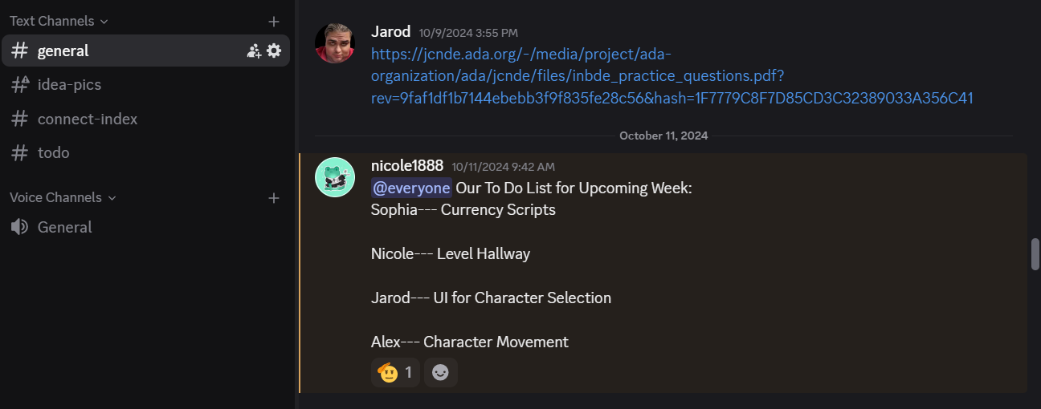
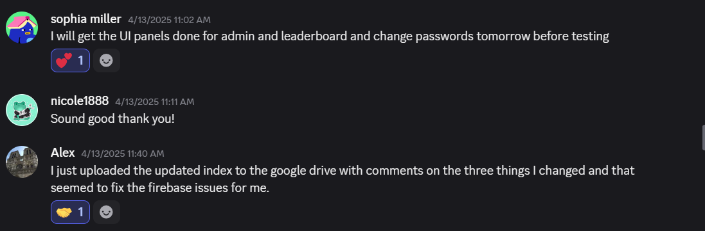
14
HOW WE COLLABORATE
Google Drive
Documents
GitHub
Code
Discord
Team communication
Microsoft Outlook
Client communication

Slide 29
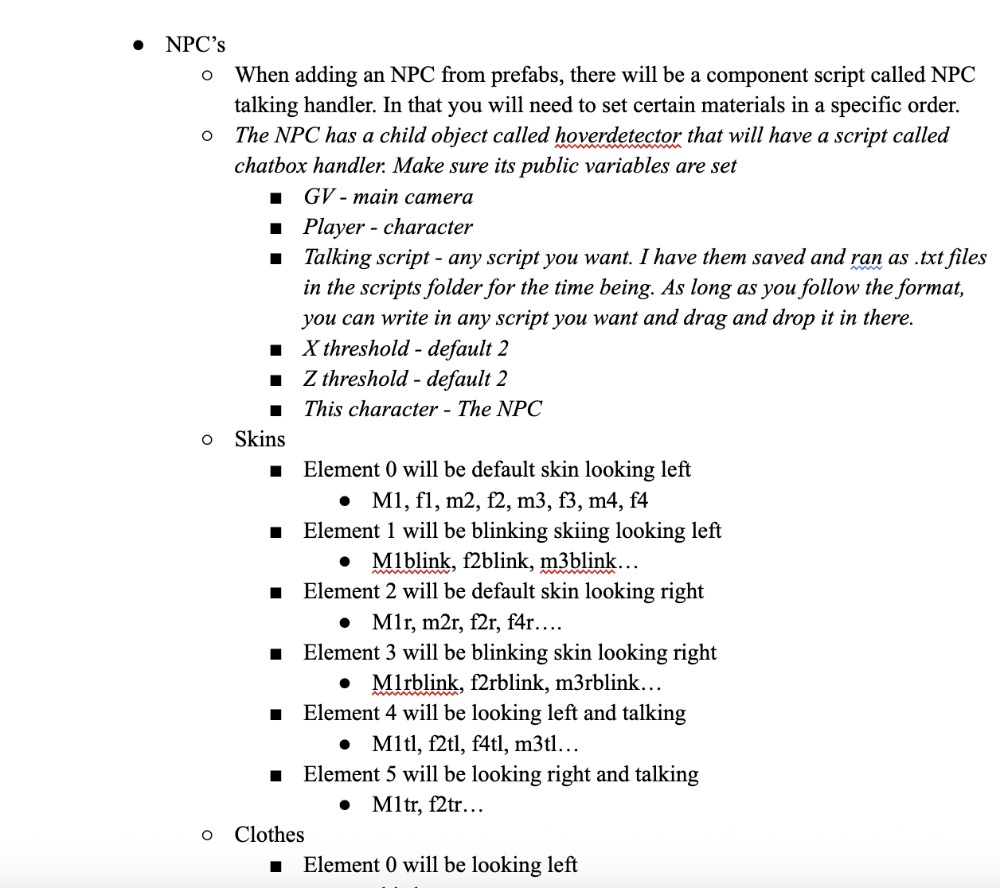
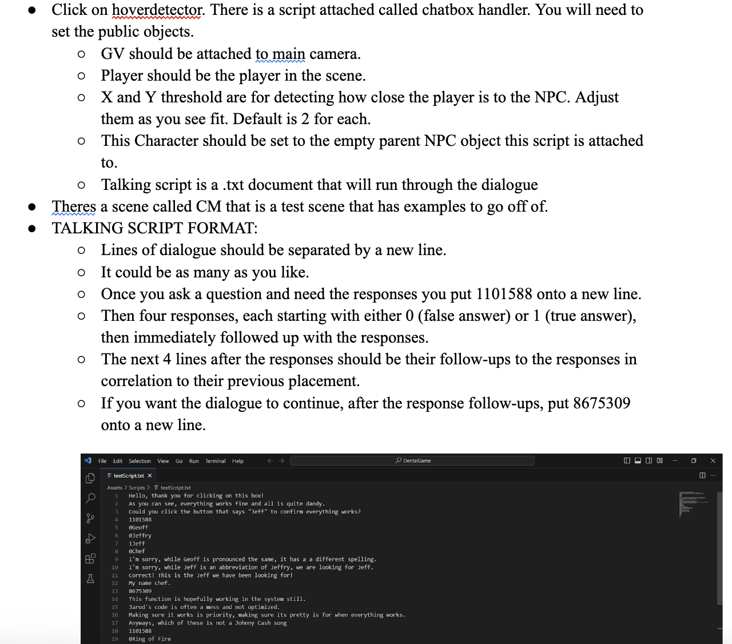

15
DOCUMENTATION

Slide 30
16
THANK YOU!
Any Questions?
?
?
?
?
?
?
?
?
?
?

